Slide 1

The Importance of Telling Difficult Family Stories
without traumatizing your reader
Studies that discuss family trauma
How to bring family trauma to the surface
Options for self-publishing your family history
How to write about trauma in your family history

Slide 2
Dr. Judith Landau
MD, DPM, LMFT, CFLE, CIP, CAI
ARISE
Generational Trauma
Family Transitional Therapy
Do you have trauma in your family history

Slide 3

Connectedness Study: Risk taking sex
Sample 1: Women in a STD Medical Clinic
Sample 2: Center for Troubled Adolescent Girls
Control: Women at a Community Center
How well they knew their family stories across multiple generations.
How well they knew their culture.
How much contact they had with family members

Slide 4
Highest
Second lowest
Lowest
Did not know any family stories
Knew family stories of extreme vulnerability
Knew family stories
of resilience

Slide 5
Stories of Extreme Vulnerability
Murder, suicide, addiction and abuse across multiple generations.
Stories of Resilience
Murder, suicide, addiction and abuse across multiple generations.
The difference - One group viewed themselves as survivors and the other group viewed themselves as victims caught in an inescapable cycle.

Slide 6
Family History Holds Power
Do not avoid past trauma.
Do create a narrative of resilience.
Traumatized readers won’t read
or recommend your stories.
We must convey trauma artfully.

Slide 7

Stories reveal the feelings that accompanied the experience… [they enable] each family member to deal with potentially intense emotions within the context of a story and within the safety of the family unit. The act of family storytelling provides collective experiences of [emotional] co-regulation…
~ Compas, Connor-Smith, Saltzman, Thomsen, & Wadsworth, 2001
Mouse study

Slide 8
45 years
Explain the importance of knowing family trauma.
Have the right person ask the questions.

Slide 9
Start light and build to the harder questions.
Ask questions in chronological order and give historical context:
Tell me about your childhood.
What were you doing when JFK was shot?

Slide 10
Be specific or leave it wide open:
What was it like when your mother died?
What was the hardest experience of your childhood?

Slide 11
Hand him/her a list of questions and give them a moment; get a snack, etc, then start the interview.
Let them write their answers; no face to face interview.

Slide 12
Self-Publishing Venues
Barnes and Noble (with shipping - painfully slow)
Hardcover color journal $33 per 1 unit (500 pages)
Hardcover memoir color $21.24 1 unit (200 pages)
Amazon (without shipping)
Hardcover color journal $67.05 per 1 unit (500 pages)
Soft cover memoir b&w $5.97 per 1 unit
Digital Edition (Kindle) -$3, full color, 500+ pages
Other Self-Publishing Firms Online
Roughly $44 per book 24 unit minimum (quality unknown)

Slide 13
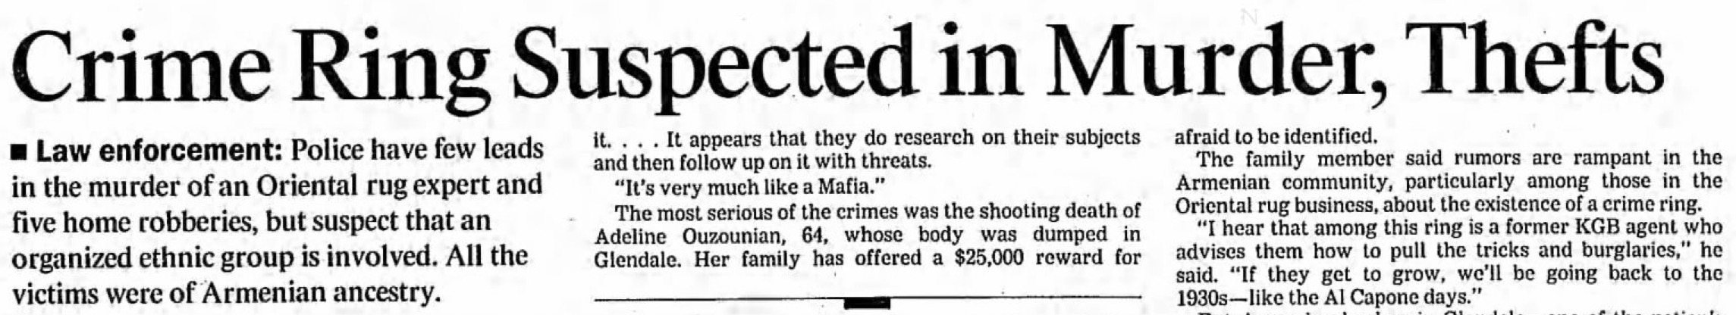
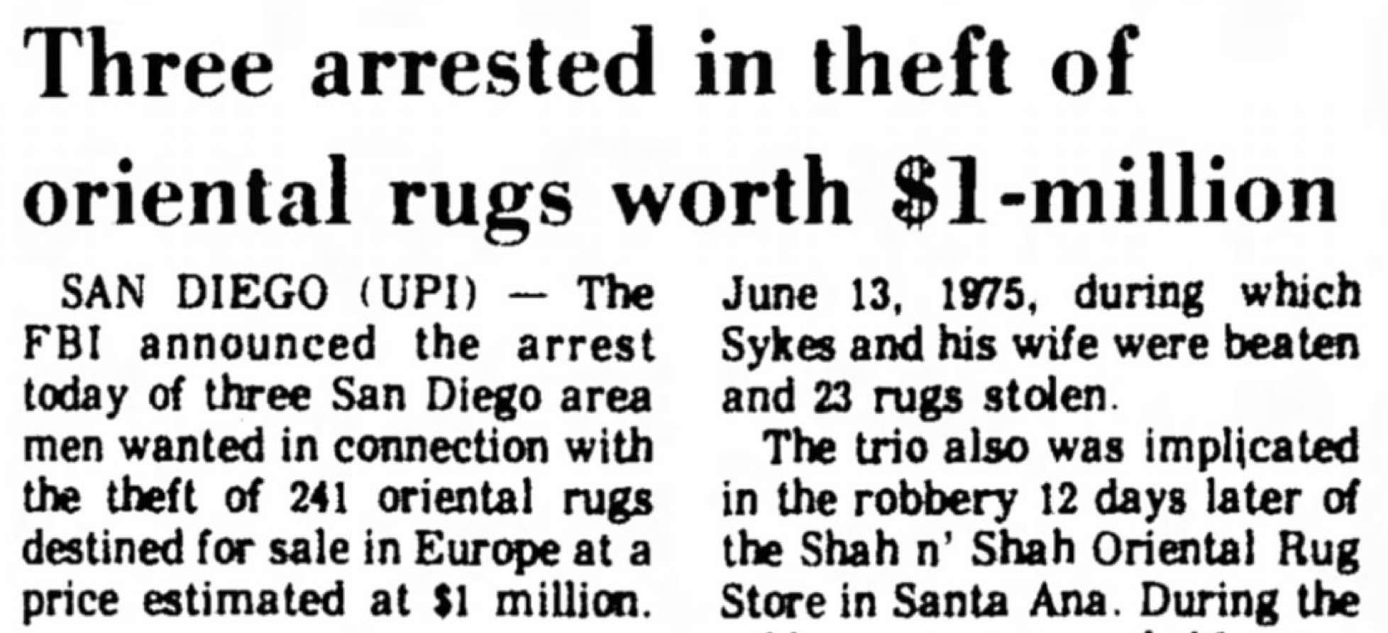
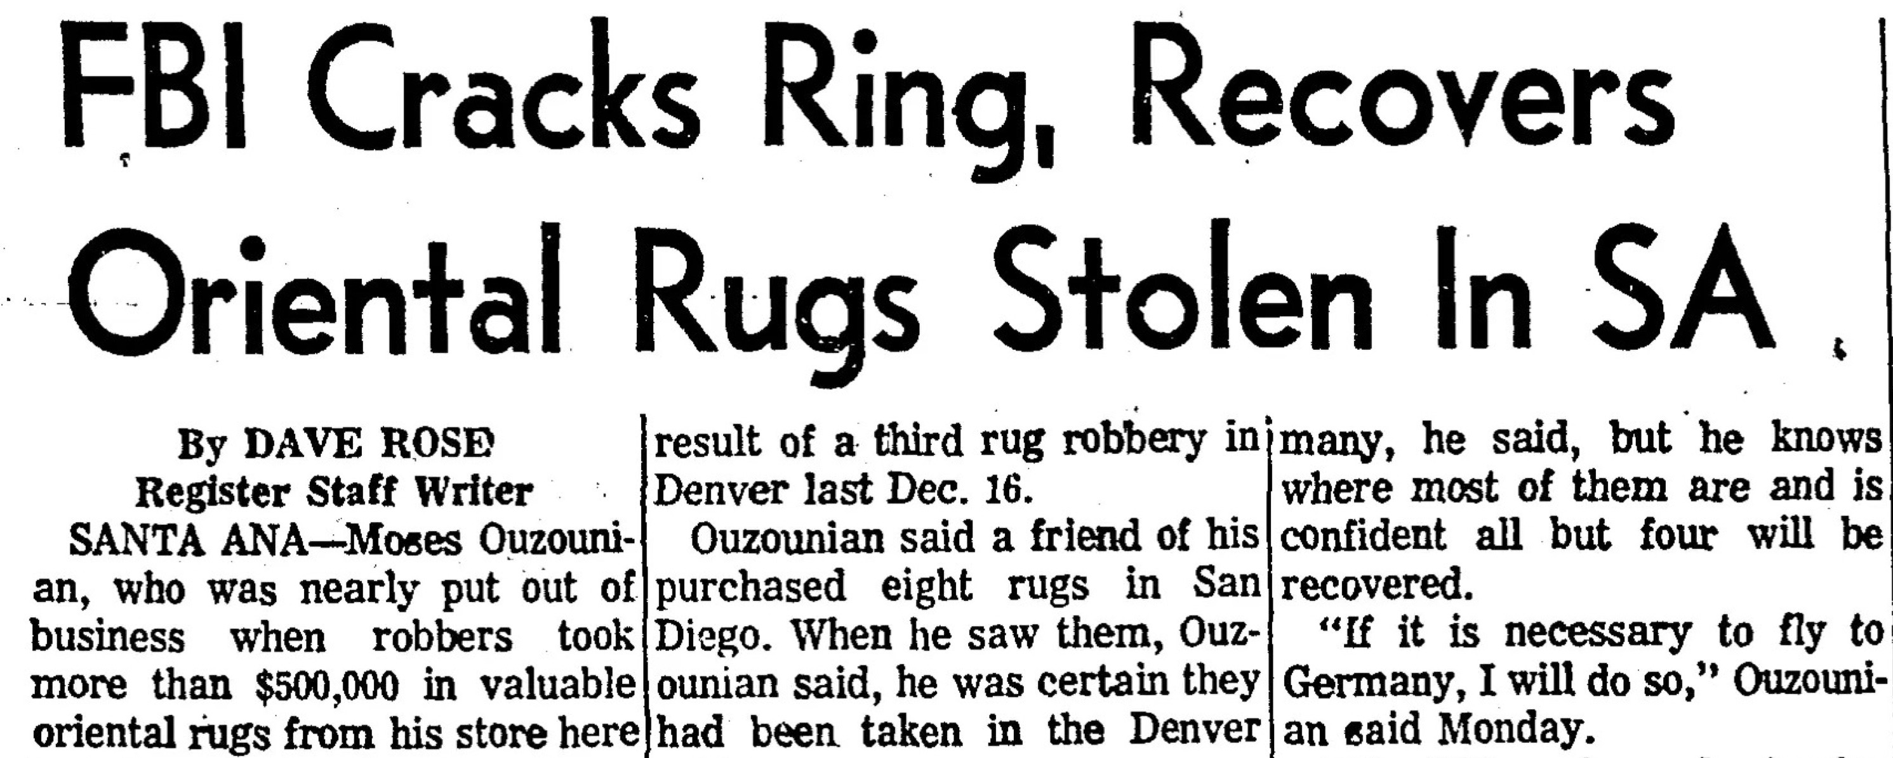
Writing Samples

Slide 14
Thank you for coming
~ get writing!

